Slide 1
A ML APPROACH FOR ONLINE COLLABORATION PLATFORMS
Welcome to my bachelor presentation

Slide 2
TABLE OF CONTENTS
01
02
03
04
05
06
Problem Scope
Current Approaches
My Proposal for a solution
Here we Identify the problem and the scope
Here We Identify the current available methods of overcoming the problem
Here I offer my proposal and solutions that I’ve come up with as well as ones Im currently investigating
Progress So Far
FAQ
Questions
Here I detail my current progress and what’s left
Here I answer a few frequently asked questions when it comes to the topic
Here I take your questions and answer them to the best of my ability

Slide 3
01
PROBLEM SCOPE

Slide 4
CURRENT PROBLEMS WITH ONLINE COLLABORATION
Online collaboration is a challenge in the world of software , as it is no secret that all software projects are poured collaborations and efforts.
Problems arise more when taking those efforts and integrating them together in a project with a significant size.
Our Scope would be Git-based collaboration platforms and version control , and specifically GitHub.
An Example of those problems arising
Overwhelming Amounts of pull and merge requests.
Absence of face to face communication.
Immense amount of effort to review code quality.
Wrong branch merges and rollbacks.
Lack of manpower to review external pull requests.

Slide 5
“It is very hard to get people in an open source project to do the things you really want or need: they participate and contribute for their own interests and with the skills they have. ....”
—OpenSource.com

Slide 6
02
CURRENT APPROACHES

Slide 7
CURRENT APPROACHES
DISCUSSION POINT
It's the most time consuming part
Pull Request
Manual Review
Accept/Reject
Even more Discussions
An External pull request is submited
A collaborator or a tech-lead would manually review the code
A verdict is reached for the code
More discussions take place back and forth

Slide 8
Can We Do Better?
How about we automate this process?

Slide 9
03
MY PROPOSAL SOLUTION

Slide 10
PIPELINE METHODOLOGY
General Constraints:
Java
Single-Class Projects
Junit Assertable
We Know The Final Desired Values
Pipeline the process of collaboration
Let the machine Come up with the verdict
Experiment:
Open Source Java Project on GitHub
An implementation is requested
Junit Tests are ready
We ask for help from contributors who will fork the repo.
It’s in essence a problem with 2 steps.
We want the most optimized and most quality with least smells

Slide 11
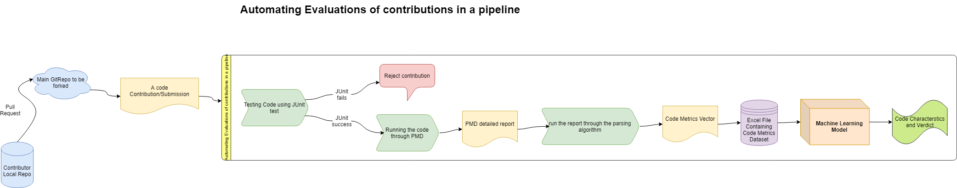
Methodology Pipeline
PMD Tool:
Statically analyzes the code into syntax trees in order to
Find some similarities that could cause code quality issues.

Slide 12
04
PROGRESS SO FAR

Slide 13
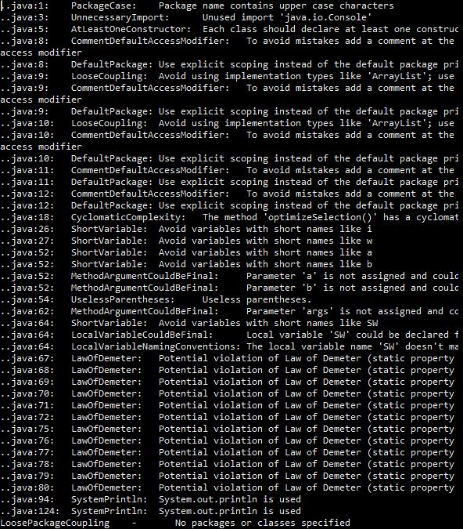
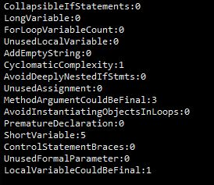
Visual Examples
A PMD Report
Code Vector Parsed
Non-Automated Metrics:
Big O Notation
Good Commit Message
Stress Test (from Junit)

Slide 14
05
WHAT REMAINS

Slide 15
06
QUESTIONS

